Slide 1
PATHWAY TO REMISSION
TYPE 2 DIABETES

Slide 2
Welcome
- Ice Breaker: What’s Your Personality
- How RANDAF Came to B
- Mission & Vision
- What is Diabetes
- T2 Diabetes Remission
- Remission vs Reversal
- Program Criteria

Slide 3
Let’s Break the Ice….
What Does Your Ice Cream Flavor Choice Says About You

Slide 4
Choose Your Flavor?
Vanilla
Chocolate
Strawberry
Coffee
Mint
Caramel Cookie Dough
Cookies and Cream
Rocky Road Pistachio
One-Ingredient Banana
Bubble Gum
I don’t like ice cream!

Slide 5
How RANDAF Came to Be
Ruby A. Neeson Diabetes Awareness Foundation was formed in 2010 as a support group for individuals and families affected by diabetes. On February 15, 2012, the organization was incorporated in the state of Georgia as a nonprofit charity and received 501c3 status in June of 2012.

Slide 6
RANDAF advances multidisciplinary diabetes educational programs with a center of attention on medically underserved communities and populations throughout the state of Georgia.
Mission
Vision
Subside the diabetes burden by implementing behavior change strategies to eradicate health disparities. Our work executes evidence-based practices and innovative approaches to promote social, emotional, and economic wellness and well-being.
To decrease the rapid growth of diabetes by addressing social detriments of health and creating supportable opportunities for those affected by diabetes, to live healthier and longer lives, preventing the life-threatening complications.
Our Core Values: Positive Change. Leadership. Empowerment. Good Stewardship. Community.

Slide 7
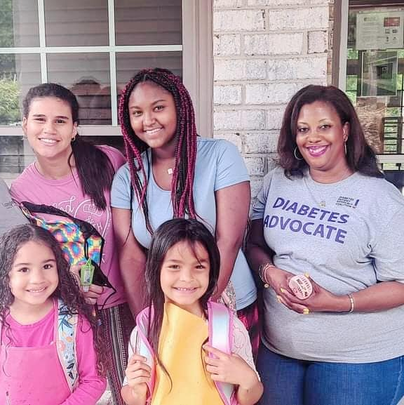
‘8 Dimensions of Wellness Model…
We strive to build long-lasting wellness rather than treat disease… By applying the ‘8 Dimensions of Wellness Model.

Slide 8
Team RANDAF in action!

Slide 9
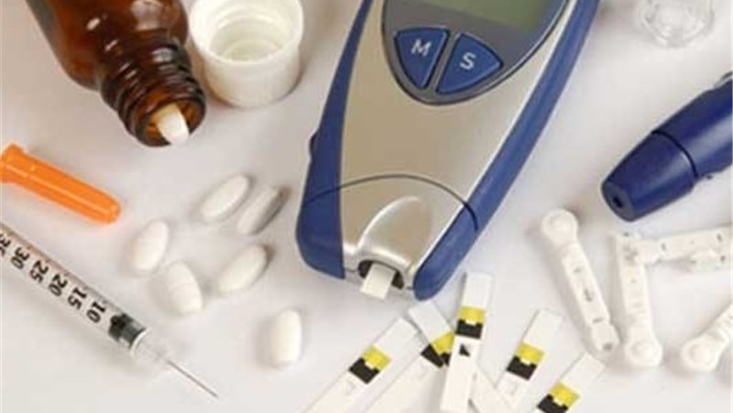
“Health is a state of complete physical, mental and social well-being and not merely the absence of disease or infirmity.” – World Health Organization.

Slide 10
What is Diabetes: a group of diseases that result in too much sugar in the blood (high blood glucose).
Type 1
Type 2
Also called juvenile diabetes, T1 is a chronic condition in which the pancreas produces little or no insulin.
It typically appears in adolescence.
Symptoms include increased thirst, frequent urination, hunger, fatigue, and blurred vision.
Treatment aims at maintaining normal blood sugar levels through regular monitoring, insulin therapy, diet, and exercise.
Also called adult-onset diabetes, T2 is a chronic condition that affects the way the body processes blood sugar (glucose).
With type 2 diabetes, the body either doesn't produce enough insulin, or it resists insulin.
Symptoms include increased thirst, frequent urination, hunger, fatigue, and blurred vision. In some cases, there may be no symptoms.
Treatments include diet, exercise, medication, and insulin therapy.

Slide 11
T2 Umbrella: Prediabetes
Also called impaired glucose tolerance, Prediabetes is a serious health condition where blood sugar levels are higher than normal, but not high enough yet to be diagnosed as type 2 diabetes. Approximately 98 million American adults—more than 1 in 3—have prediabetes.
Of those with prediabetes, more than 80% don't know they have it.

Slide 12
T2 Umbrella: Gestational diabetes
Also called diabetes during pregnancy, gestational diabetes occurs when your body can't make enough insulin during your pregnancy. Insulin is a hormone made by your pancreas that acts like a key to let blood sugar into the cells in your body for use as energy.

Slide 13
“Your body holds deep wisdom. Trust in it. Learn from it. Nourish it. Watch your life transform and be healthy.”

Slide 14
Team RANDAF in action!

Slide 15
T2 Diabetes Remission Program
A type 2 prevention program is an evidence-based year-long lifestyle change program to help participants who are at risk for type 2 diabetes adopt sustainable, healthy lifestyle choices.
A key objective is to successfully make lifestyle and behavior changes to prevent or delay type 2 diabetes.

Slide 16
Program Feature
• Hybrid, innovative, interactive learning
• Evidence-based curriculum
• Guest presenters
• Community resources
• Group outings
• Ongoing support....and more!

Slide 17
Program Qualifications
• Must be aged 18 years or older
• Demonstrate at least two T2D risk factors
• No previous diagnosis of diabetes
• Not pregnant at time of enrollment
• Willing to prioritize your health!

Slide 18
Hybrid Class Schedule
Weekly First Six Months
-3 virtual sessions and 1 in=person
Virtual class is on 1st Thursday at 11:00 am or 6:00 PM EDT
In-person sessions are at 11:00 AM
Once a month after first 6 months (in-person) at 11:00 AM

Slide 19
Important to Know
• Supplementary sessions are allowed
• Consecutive absenteeism can cause removal from cohort
• A graduation ceremony will be held at the conclusion of the 12 months
• On-going support is available via social support groups

Slide 20
Team RANDAF in action!

Slide 21
REMARKS/QUESTIONS/ CONCLUSION

